Slide 1
Modeling Image Effects using MATLAB
By Andrew Katz
Instructor: Nicholas Dwork
Stanford Pre-Collegiate Summer Institutes 2015

Slide 2
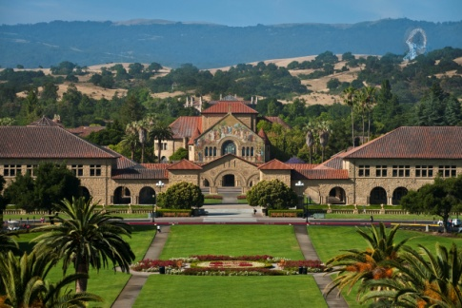
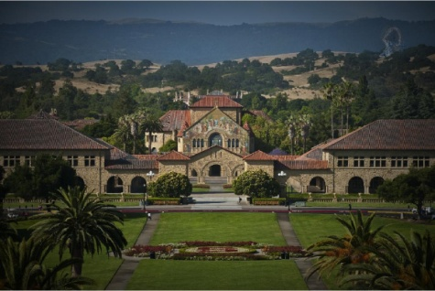
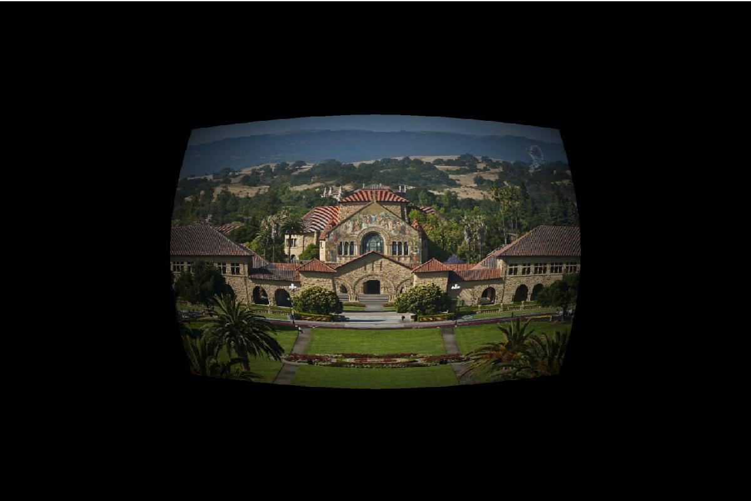
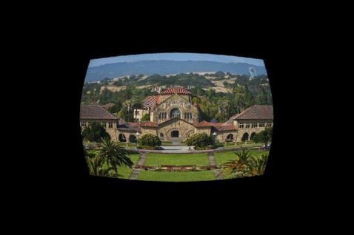
Applying Image Effects
Image effects can be applied as a function of pixel location to an image as a matrix.
These effects only apply to a single color, so an effect must be applied three times, for full color.
Clockwise from the top left: Original, vignette, radial distortion, vignette and radial distortion.

Slide 3
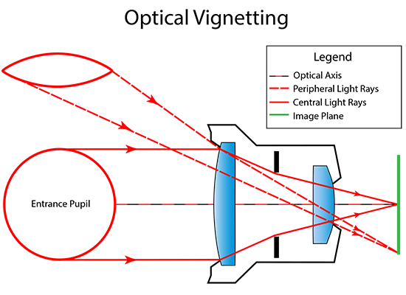
Vignettes
A vignette occurs because imperfect lenses refract differently towards the edge, and less light reaches a pixel in the center.^{[1]}
A vignette can be modeled by cos⁴(θ)
A vignette may be simulated in computer graphics for animation, etc…
https://cdn.photographylife.com/wp-content/uploads/2013/10/Optical-Vignetting.png

Slide 4
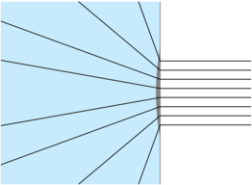
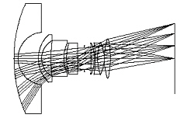
Radial Distortion
Radial Distortion occurs as a lens artifact, often with long range zoom lenses^{[2]}
Radial Distortion can be modeled with a Taylor Series, a polynomial which as the degree increases, the function more closely matches the true, infinite series it models.^{[2],[3]}
http://i.stack.imgur.com/Y4cJx.png
http://www.bobatkins.com/photography/technical/fov/raytrace.jpg

Slide 5
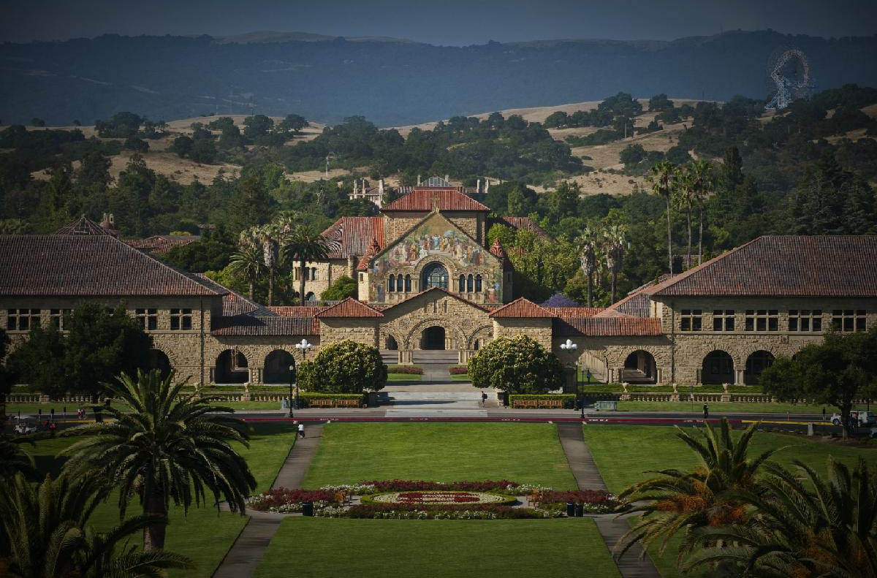
Vignetting

Slide 6
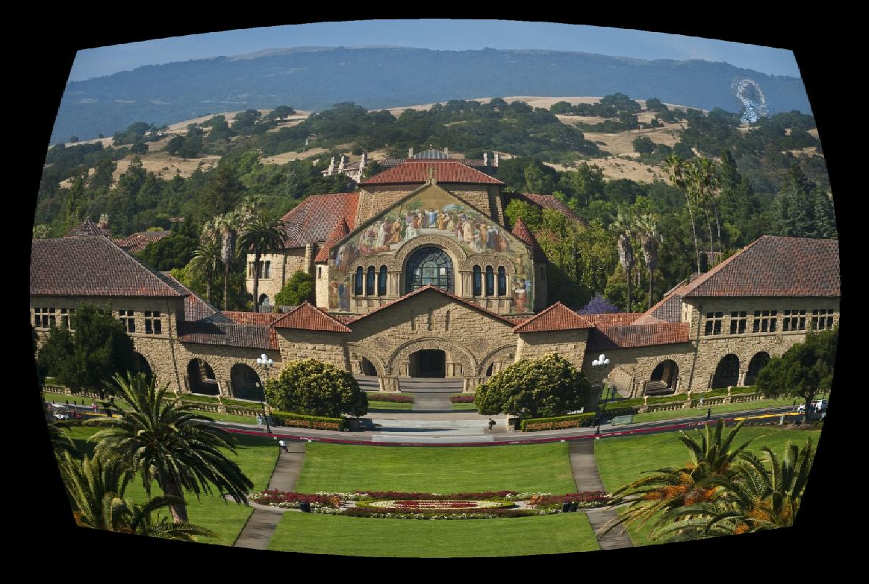
Radial Distortion (Fisheye)

Slide 7
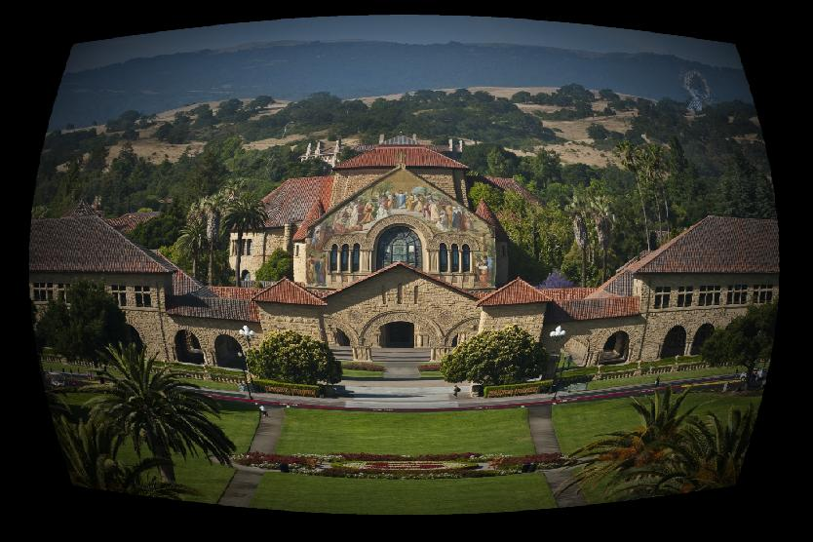
Radial Distortion and Vignetting

Slide 8
References
https://en.wikipedia.org/wiki/Vignetting
https://en.wikipedia.org/wiki/Distortion_(optics)
https://en.wikipedia.org/wiki/Taylor_series
Code for this project is available at: https://github.com/aakatz3/SPCS2015FinalProject/

